Slide 1

Title Slide: Towards a Trusted Supply Chain Project Name: MrBeans
Luca Colagrande, Giovanni Lippolis, Davide Menini, Tim Muller, Felix Stabel, Alex Waibel

Slide 2
Project Idea We focused on having a trustful end-to-end supply chain, by ensuring that every step of the chain is controlled by IoT sensors.

Slide 3
Disruption Potential
Peterson will be able to monitor every step, avoiding product contaminations and potential frauds.

Slide 4
Open Challenges
The current project can be a good starting point to solve a real-life situation, where many other contaminations of the supply chain can occur.

Slide 5
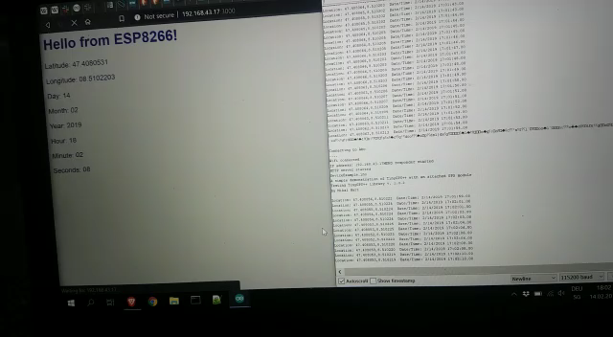
Data are recorded from the GPS (right).
A web app (left) displays them and later it will be used to pass them to the blockchain.

